Slide 1
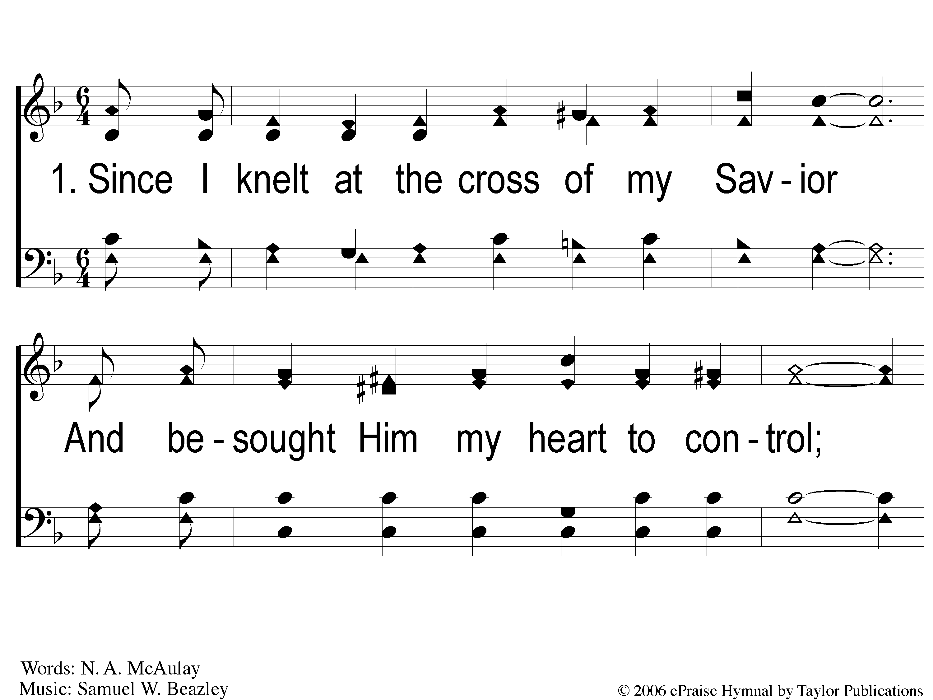
1-1 Deep Settled Peace
Deep Settled Peace
80

Slide 2
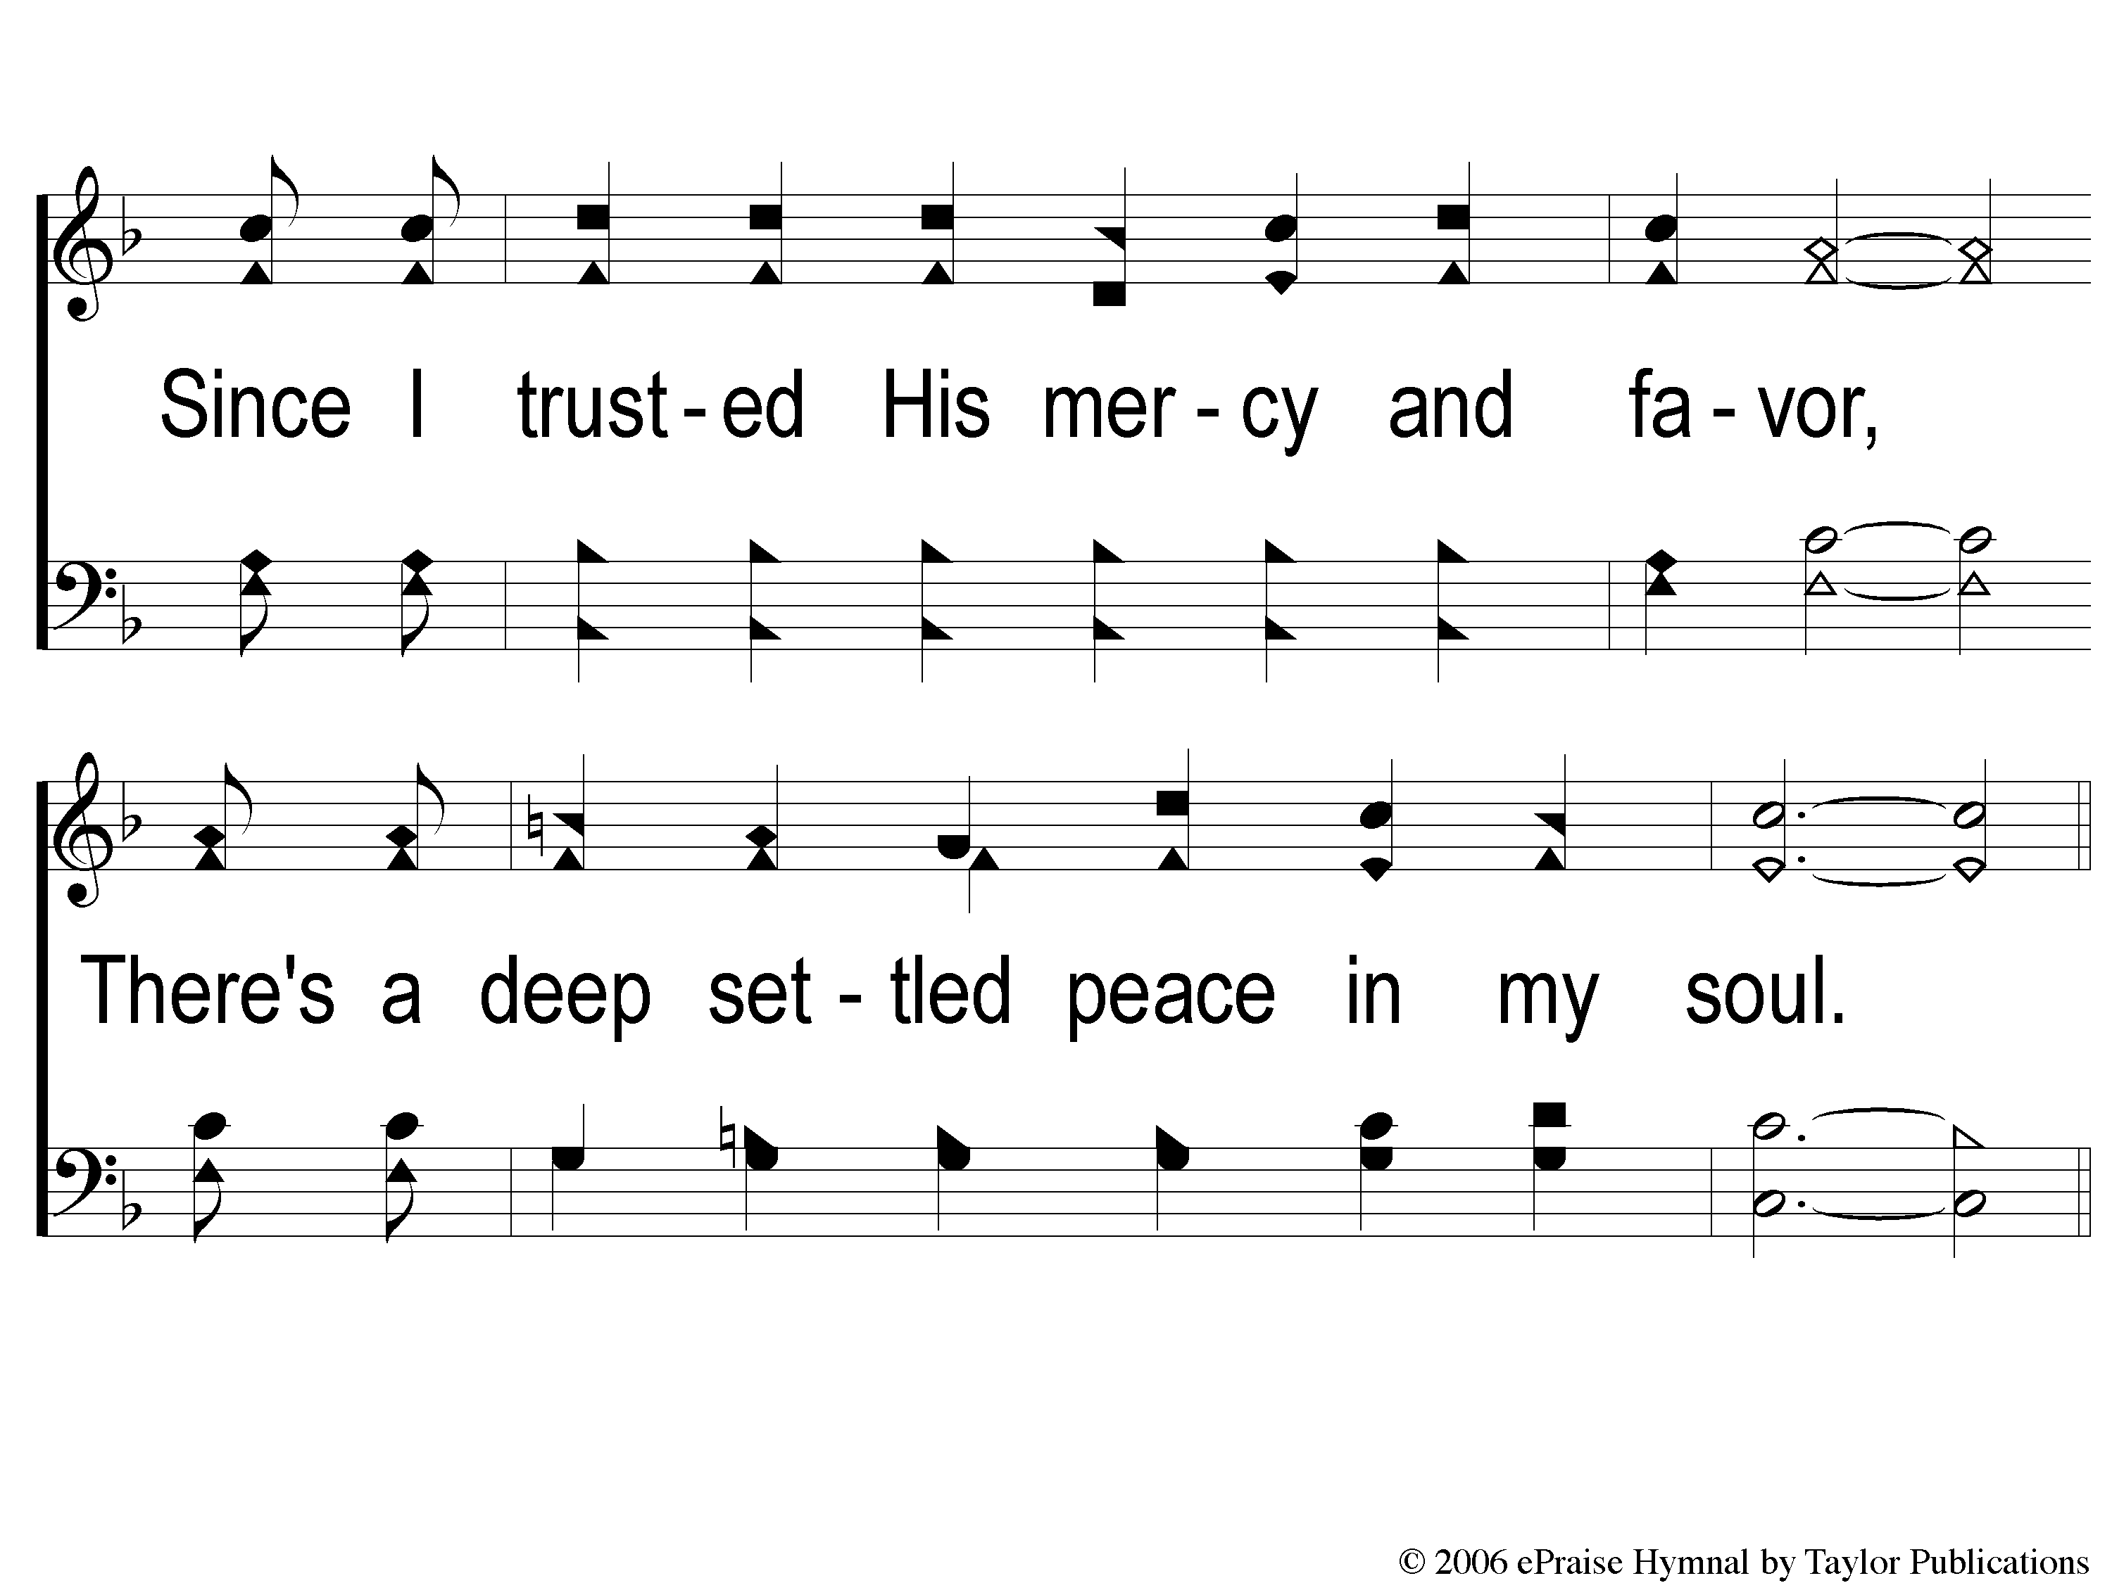
1-2 Deep Settled Peace
Deep Settled Peace
80

Slide 3
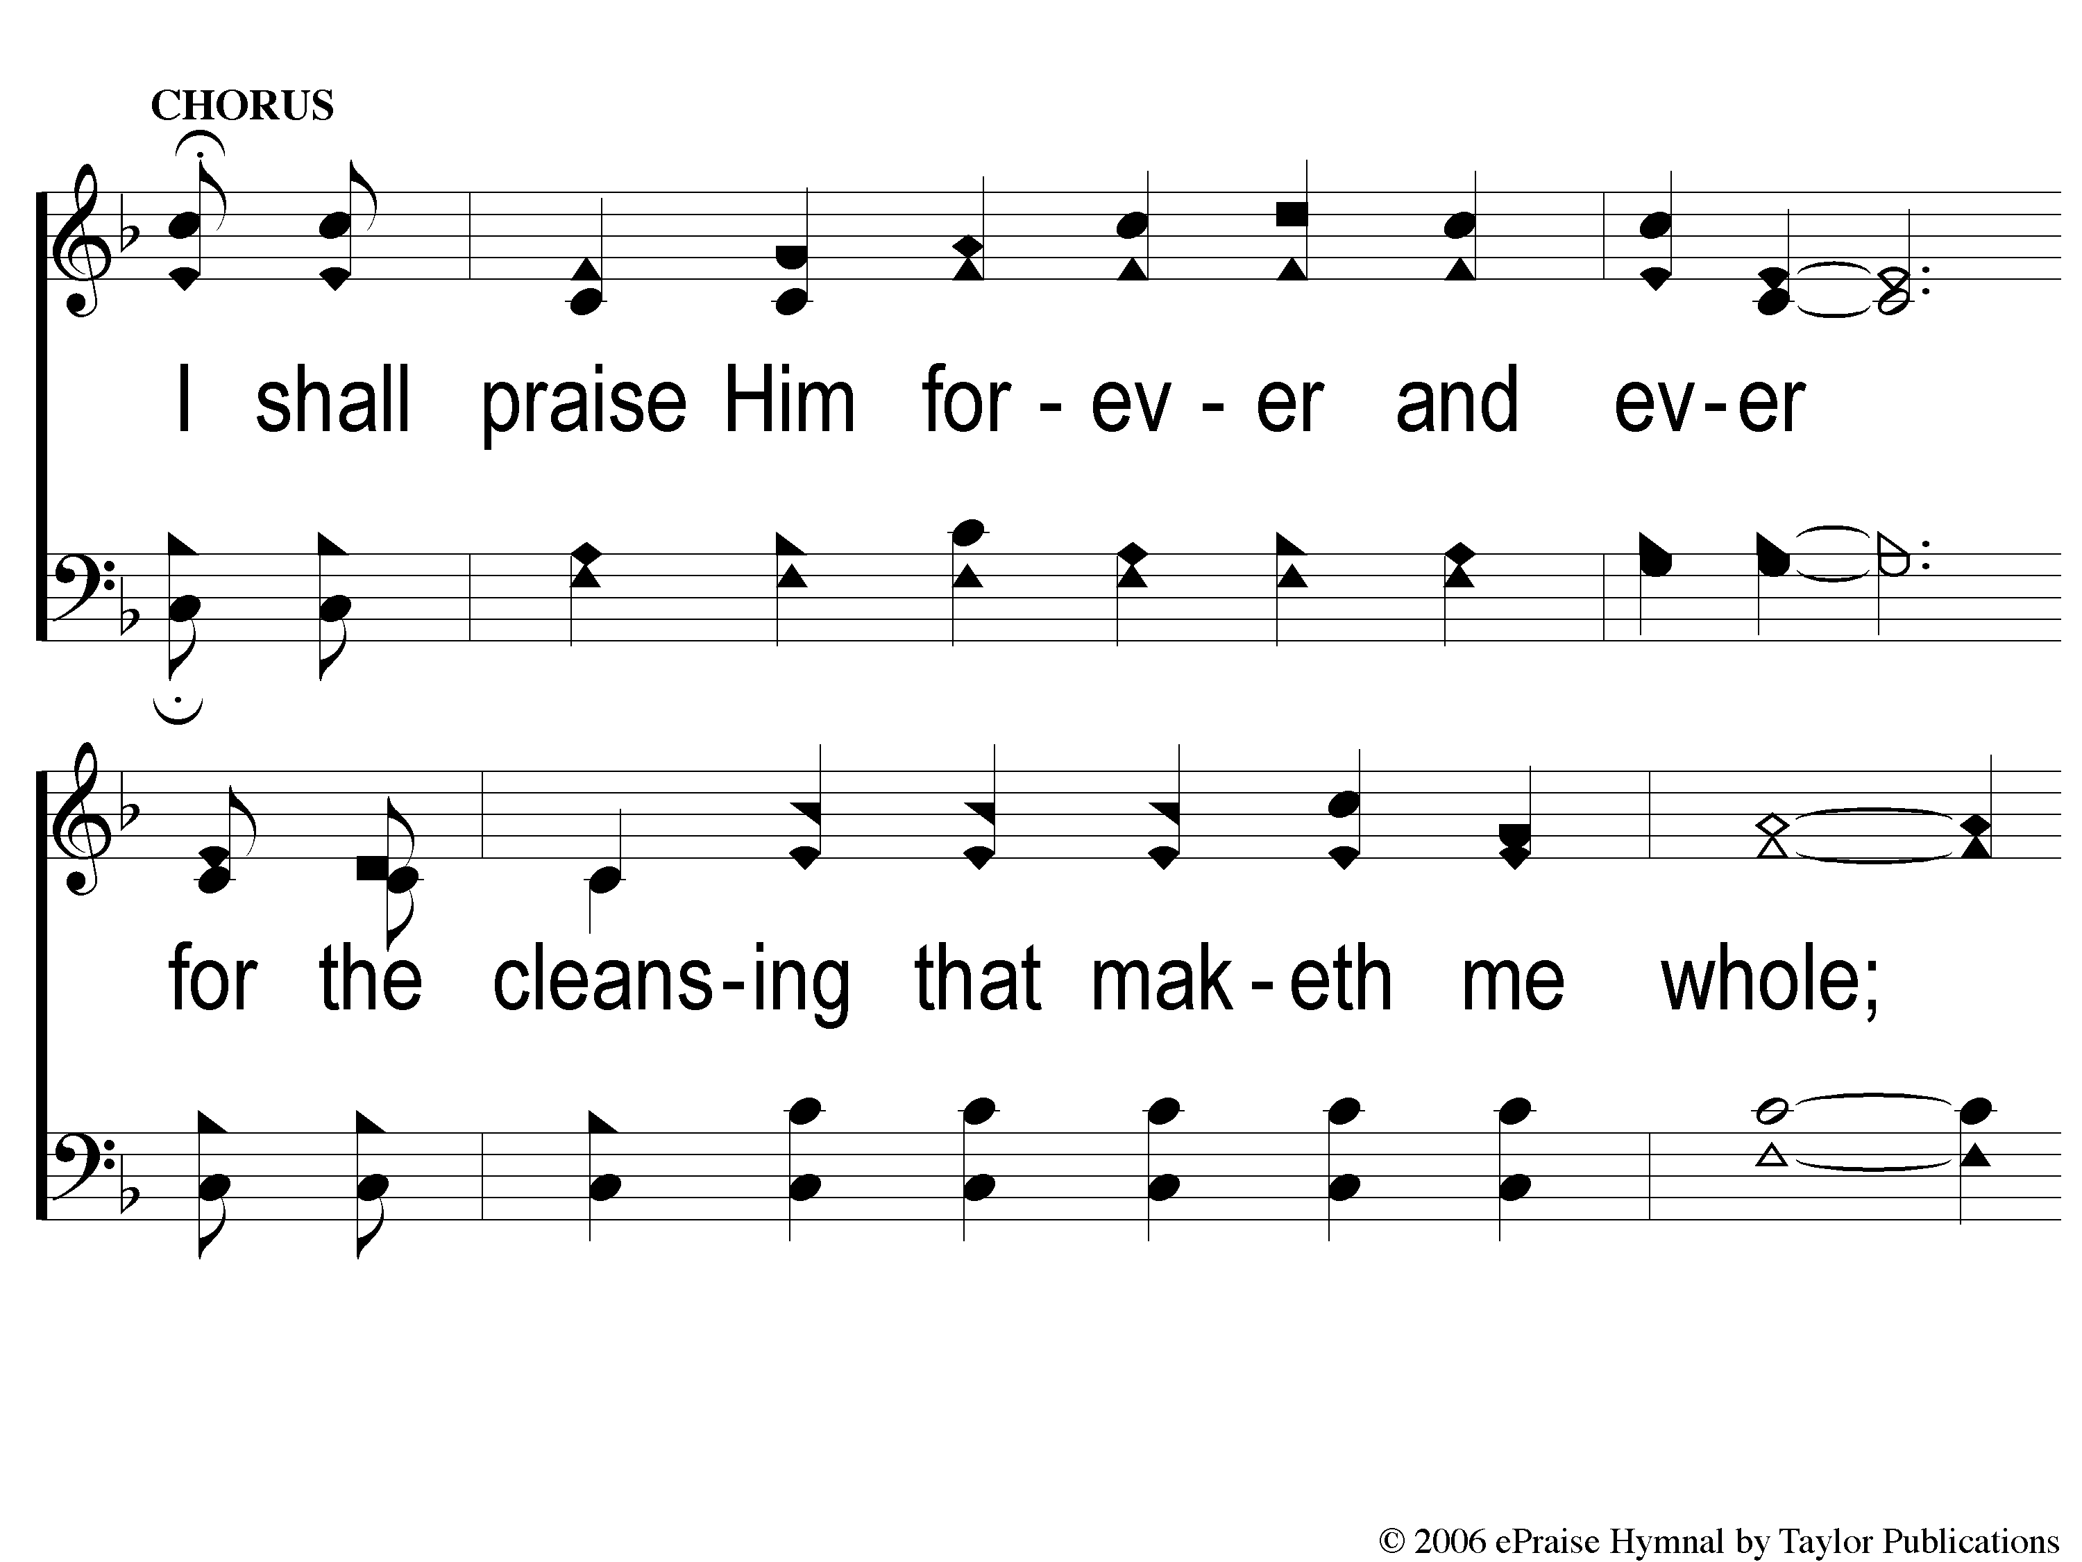
C-1 Deep Settled Peace
Deep Settled Peace
80

Slide 4
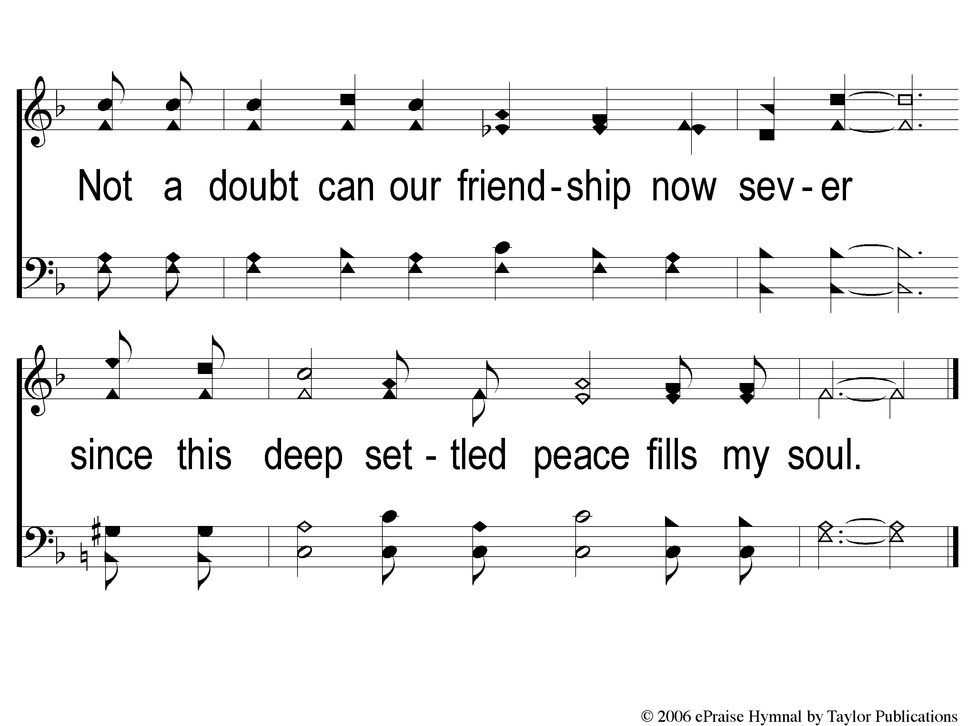
C-2 Deep Settled Peace
Deep Settled Peace
80

Slide 5
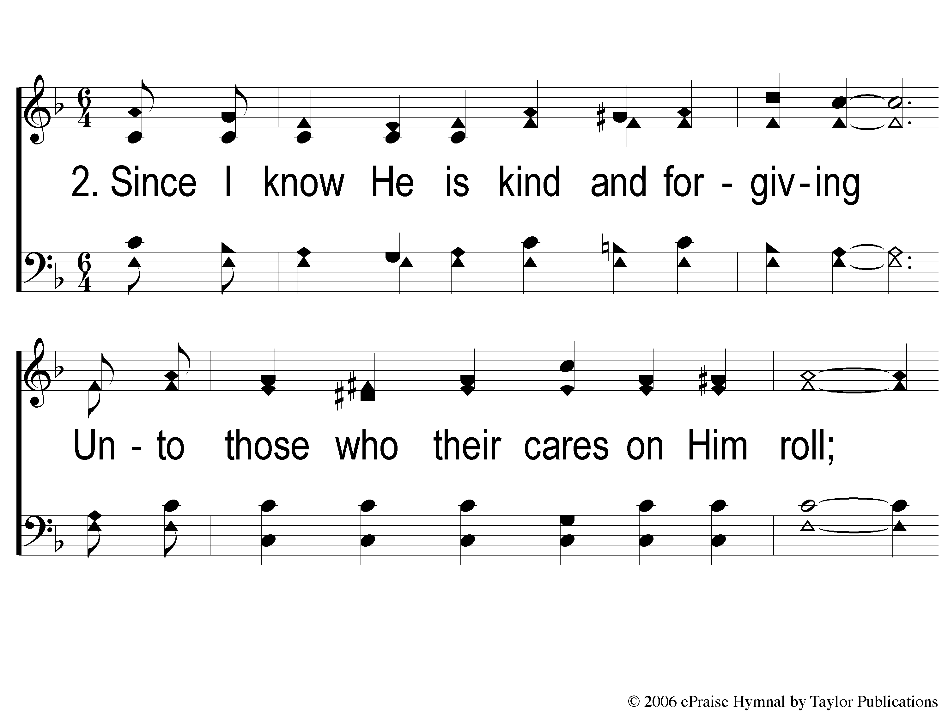
2-1 Deep Settled Peace
Deep Settled Peace
80

Slide 6
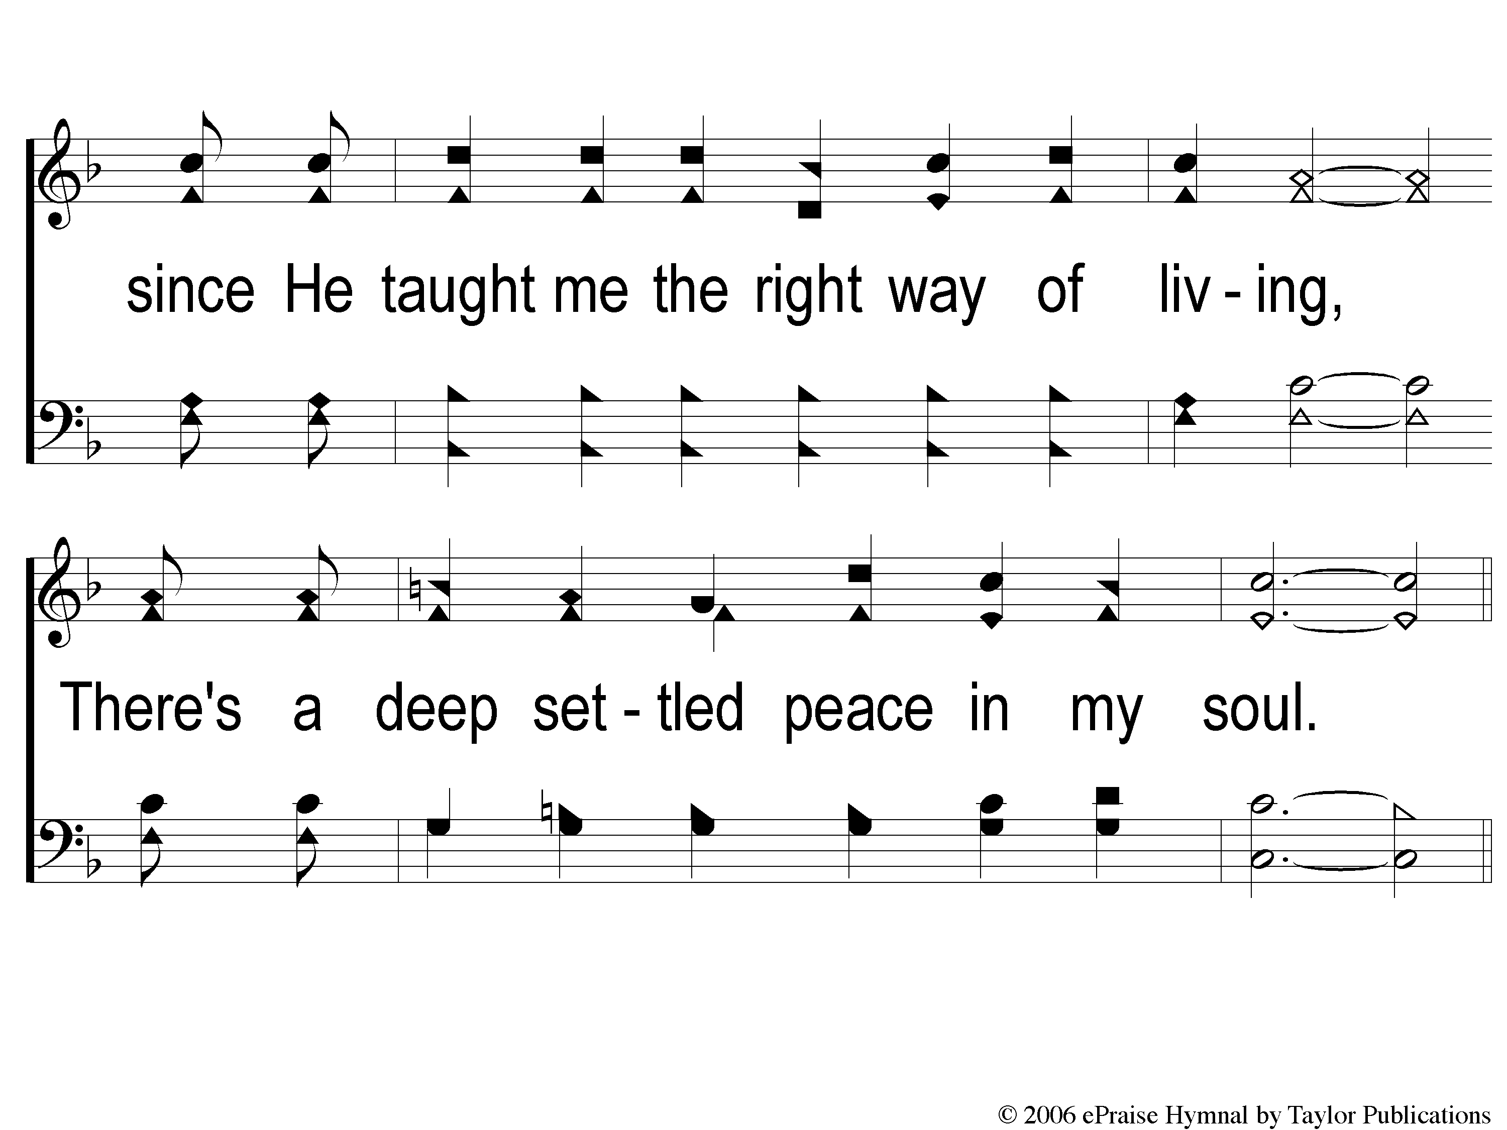
2-2 Deep Settled Peace
Deep Settled Peace
80

Slide 7
C-1 Deep Settled Peace
Deep Settled Peace
80

Slide 8
C-2 Deep Settled Peace
Deep Settled Peace
80

Slide 9
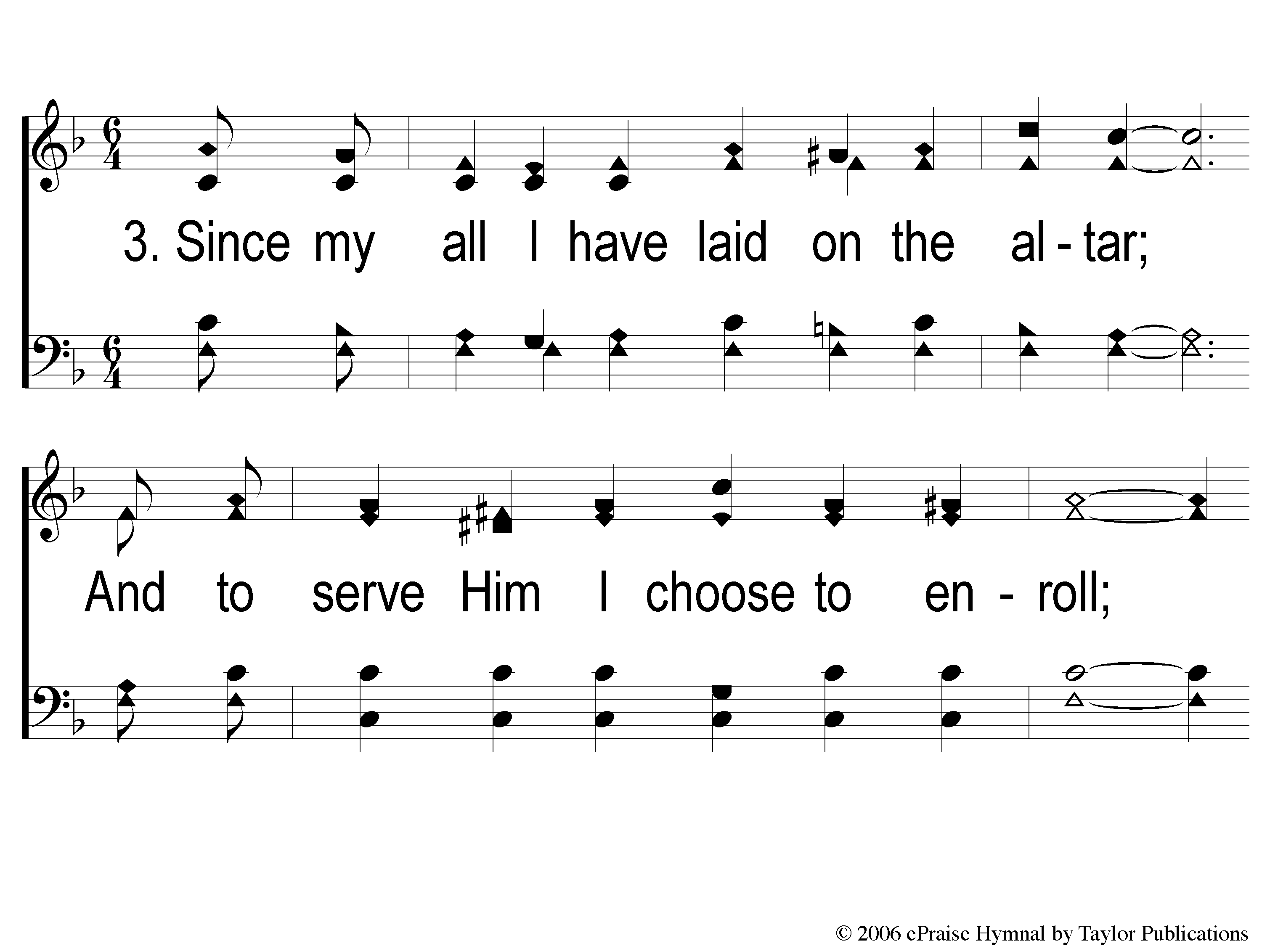
3-1 Deep Settled Peace
Deep Settled Peace
80

Slide 10
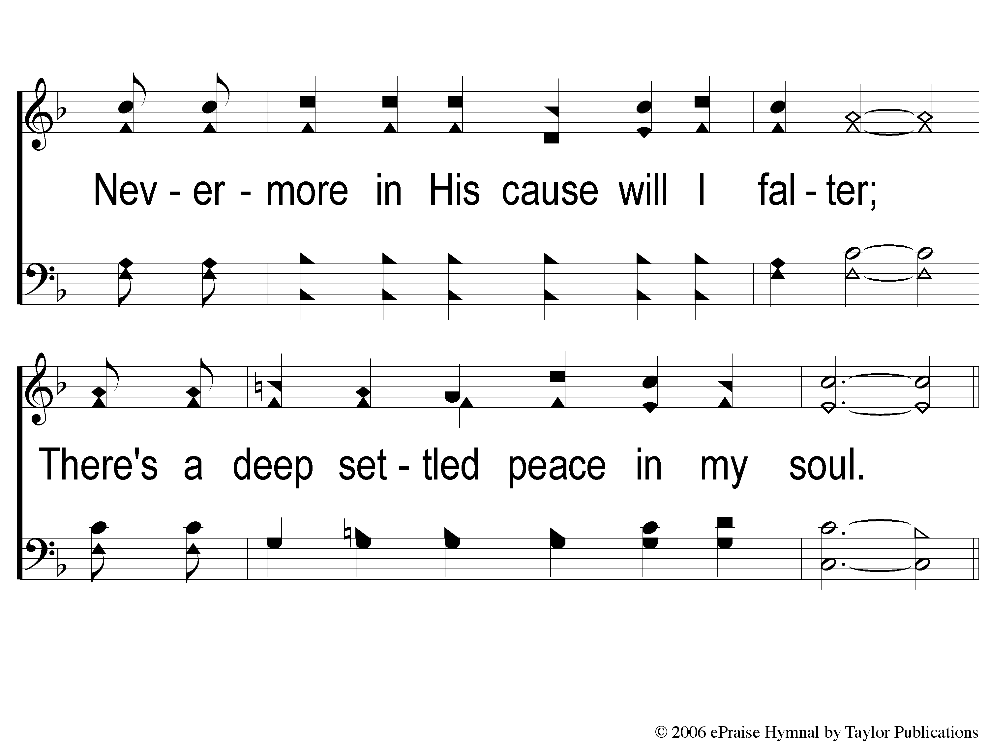
3-2 Deep Settled Peace
Deep Settled Peace
80

Slide 11
C-1 Deep Settled Peace
Deep Settled Peace
80

Slide 12
C-2 Deep Settled Peace
Deep Settled Peace
80

Slide 13
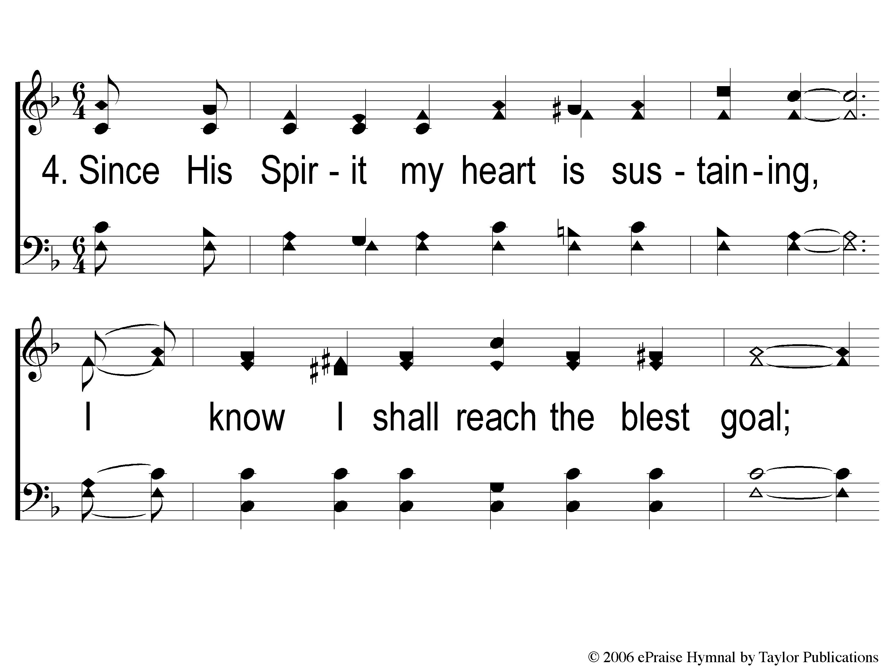
4-1 Deep Settled Peace
Deep Settled Peace
80

Slide 14
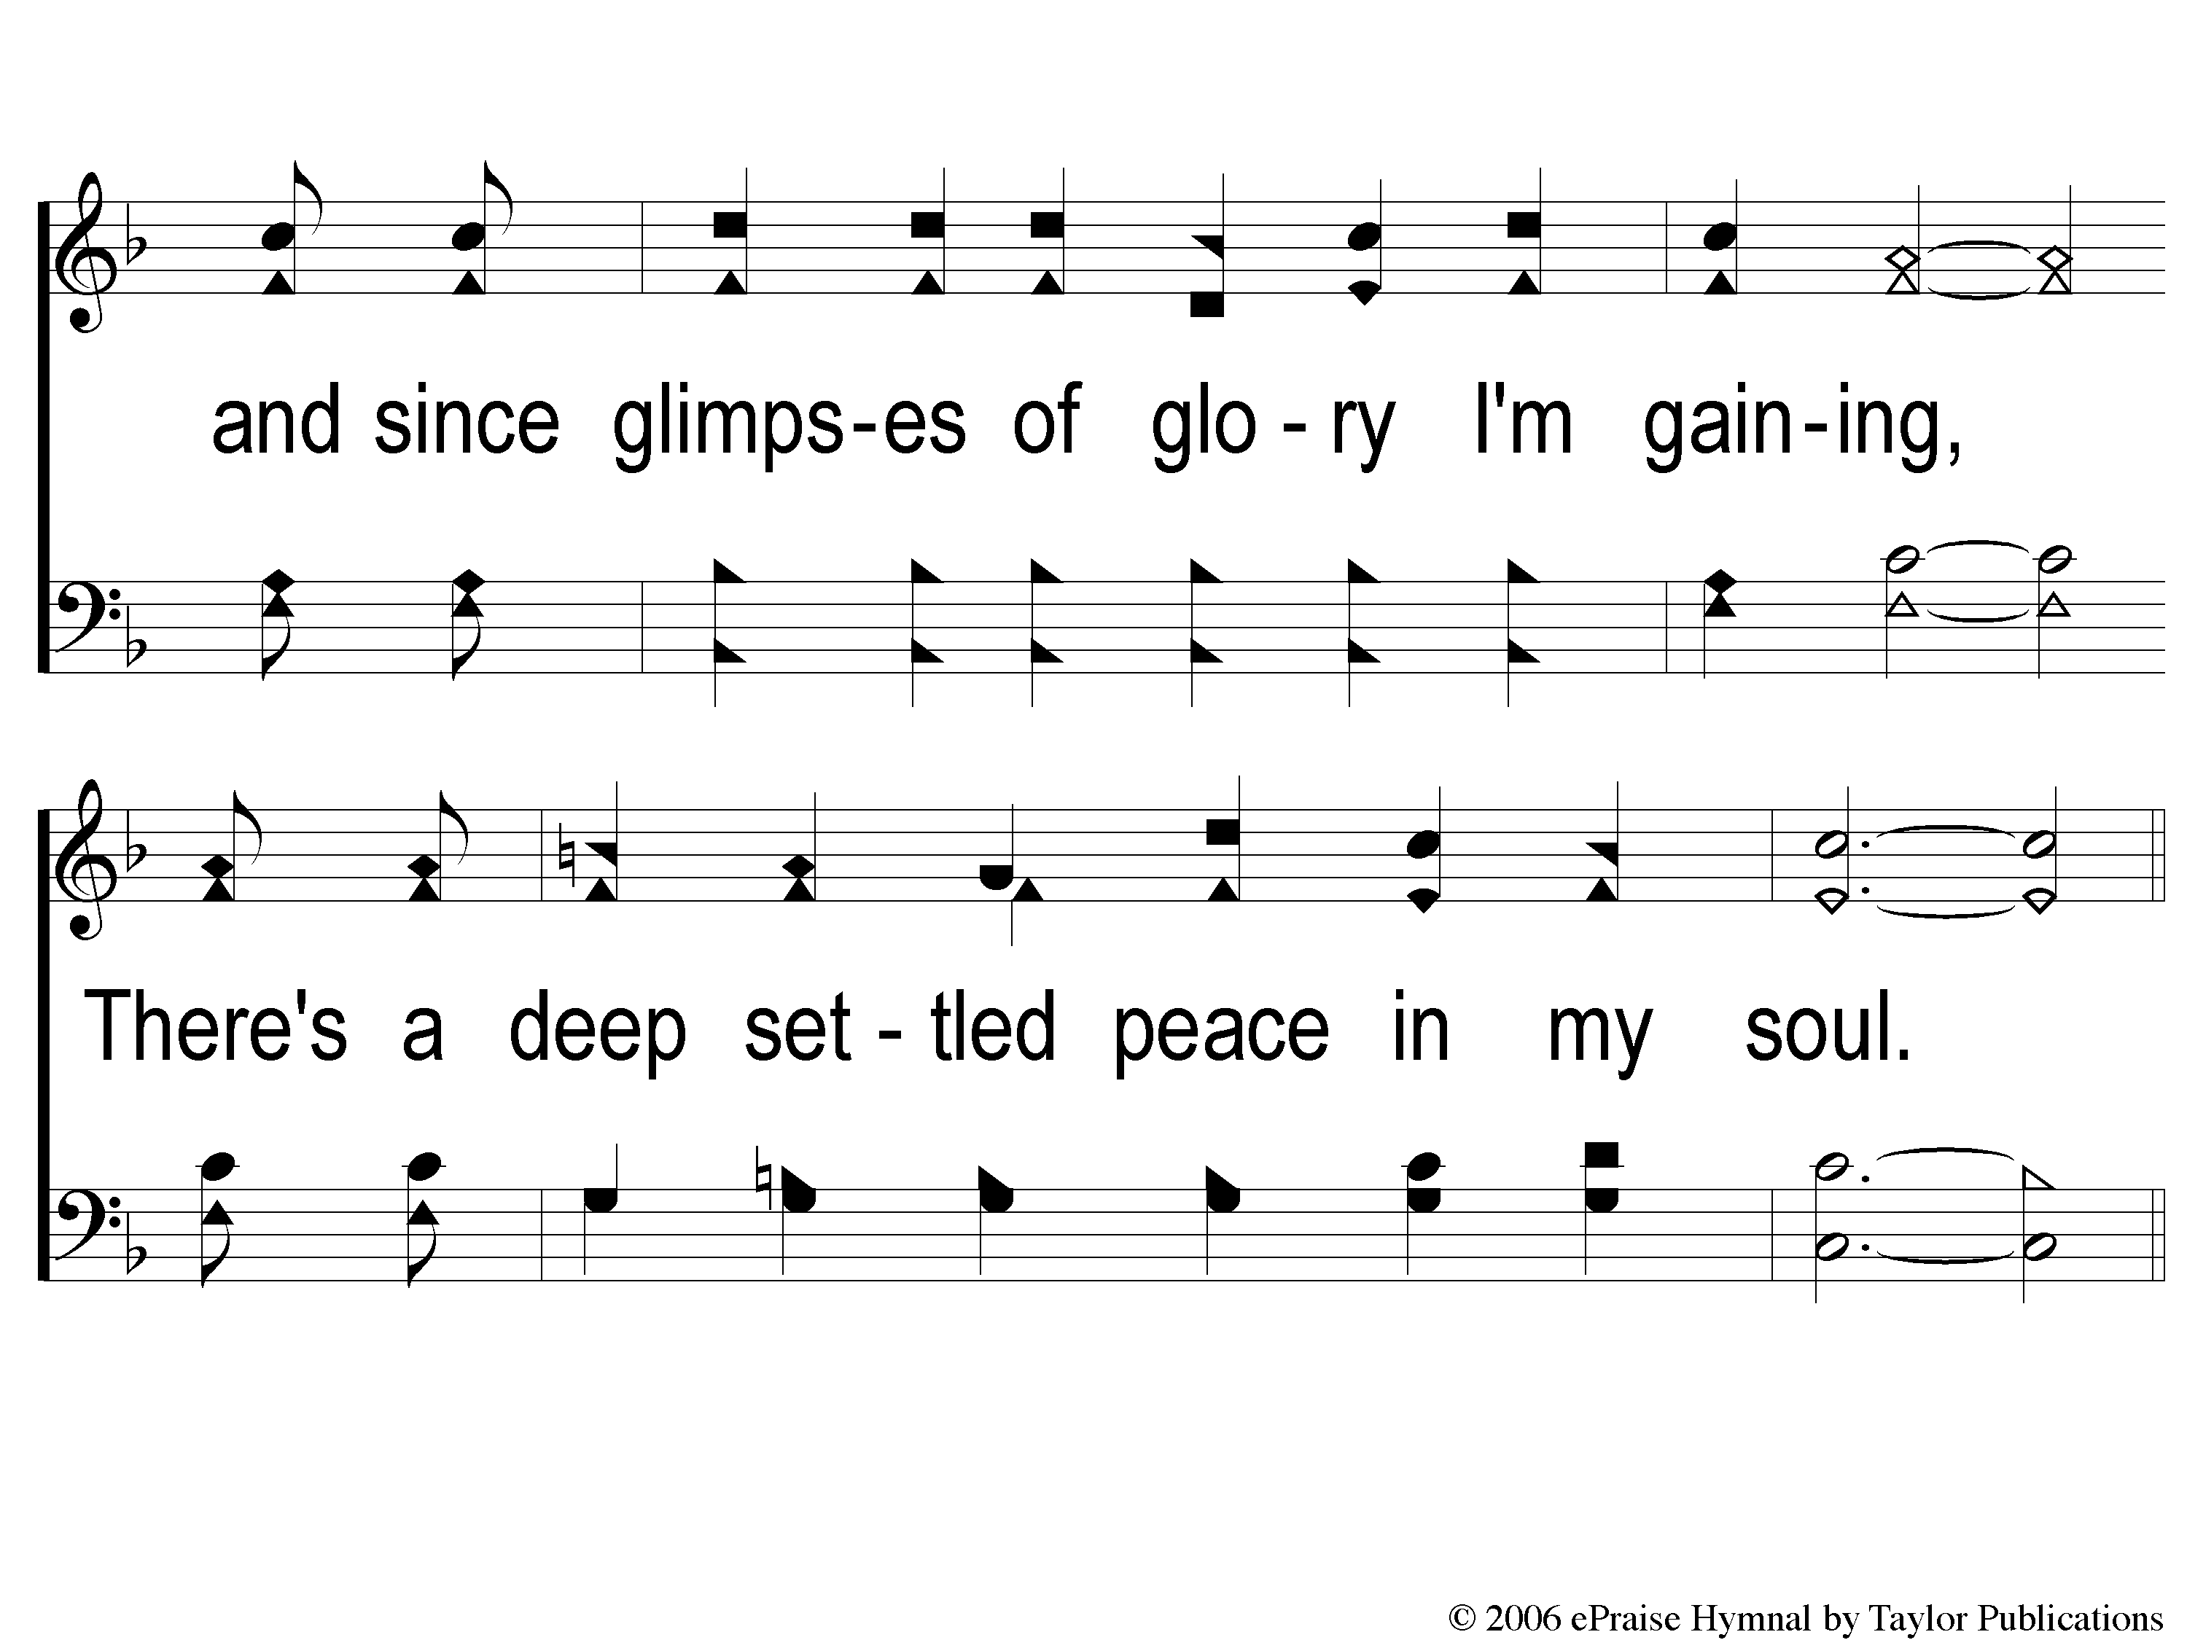
4-2 Deep Settled Peace
Deep Settled Peace
80

Slide 15
C-1 Deep Settled Peace
Deep Settled Peace
80

Slide 16
C-2 Deep Settled Peace
Deep Settled Peace
80

